Slide 1
State Diagrams
Meandering Armadillos:
Nick Montiquila, Michael Nishida, Andrew Ricci

Slide 2
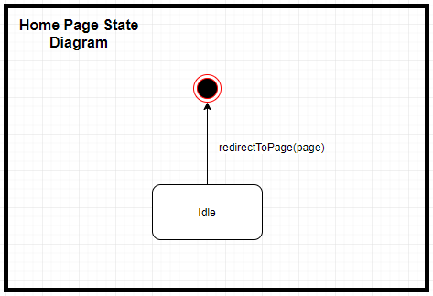
Home Page

Slide 3
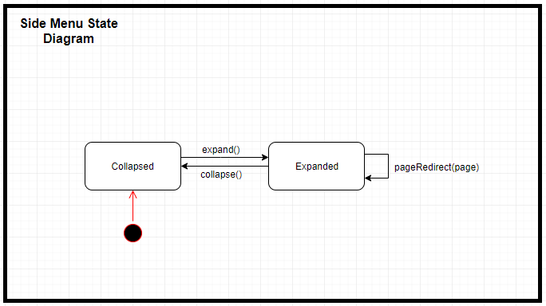
Side Menu

Slide 4
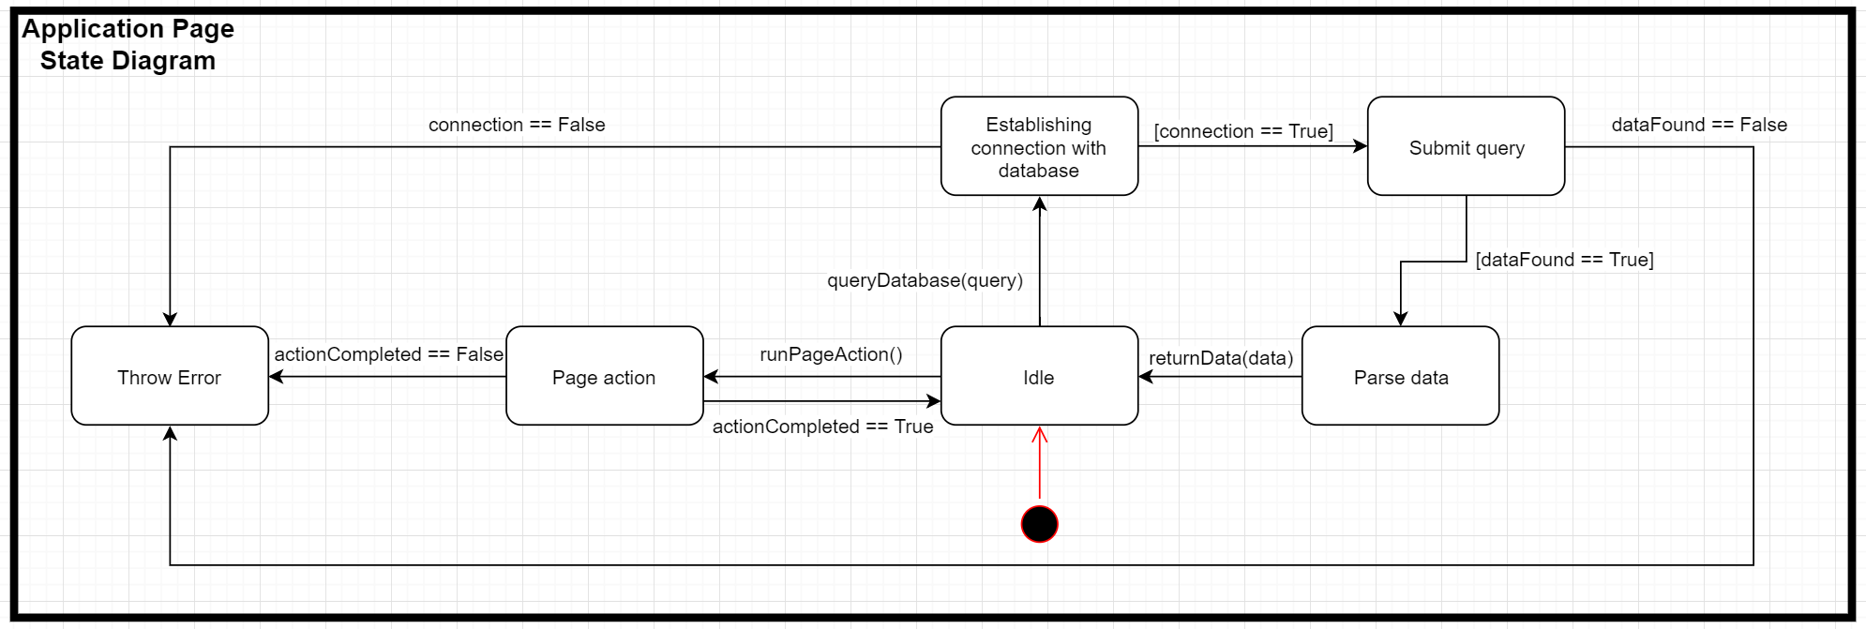
Application Page

Slide 5
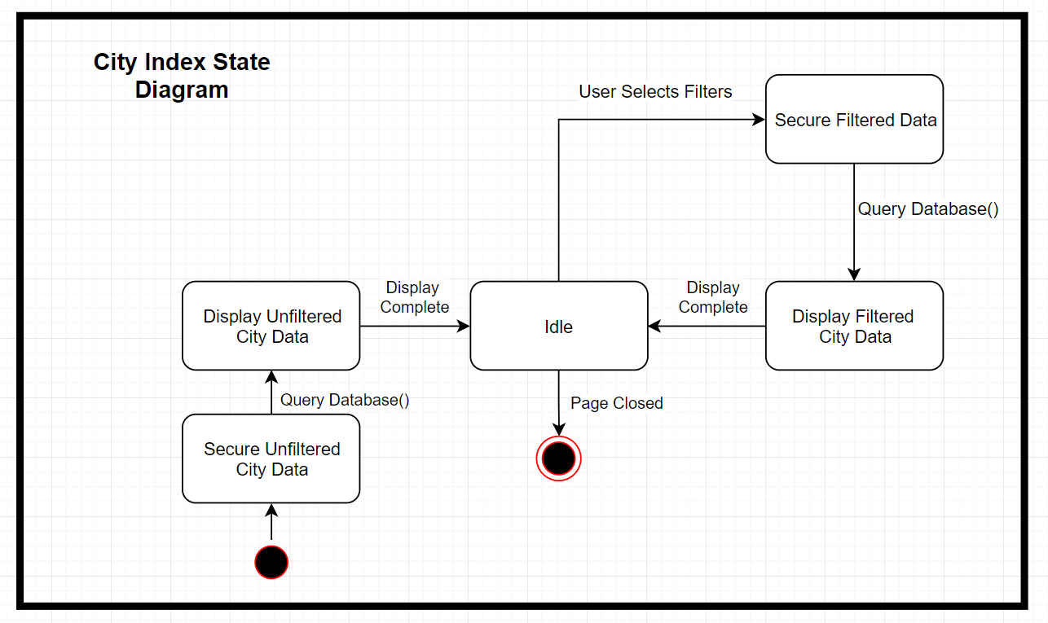
City Index Page

Slide 6
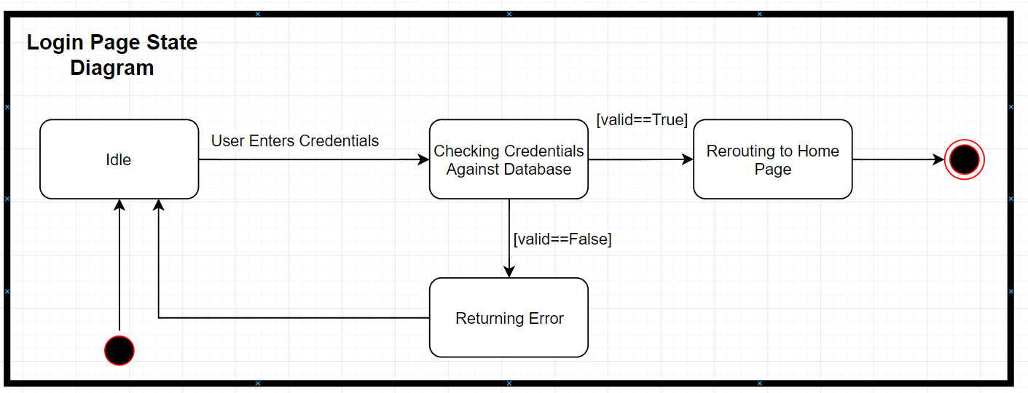
Login Page

Slide 7
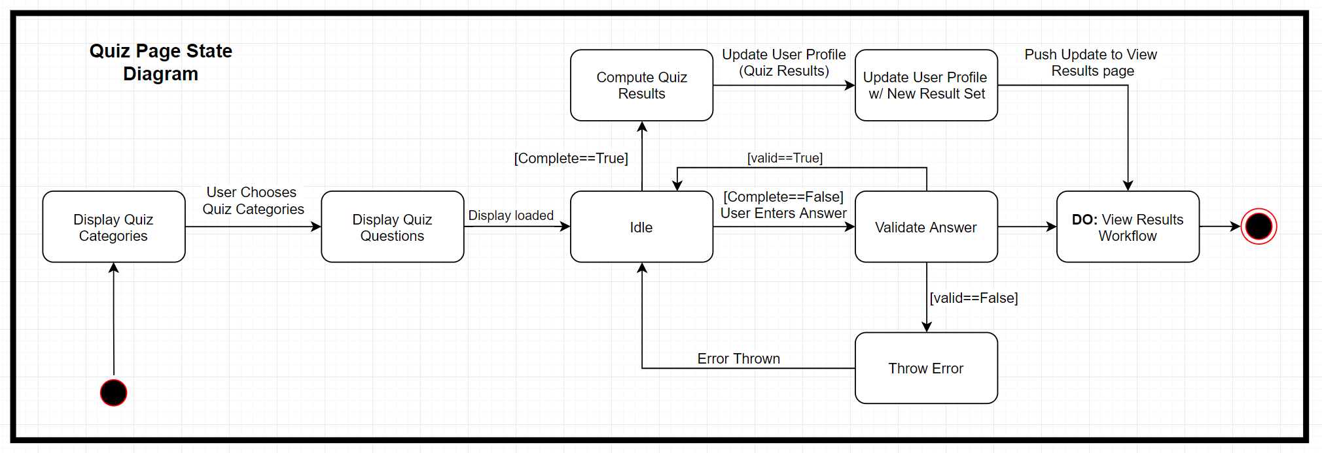
Quiz Page

Slide 8
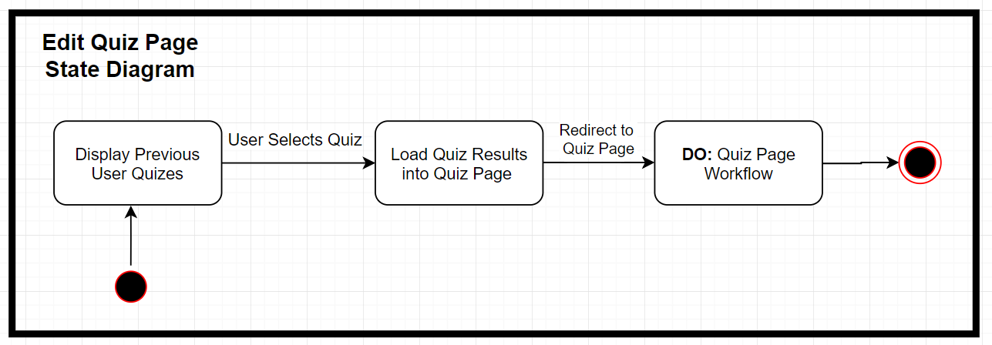
Edit Quiz Page

Slide 9
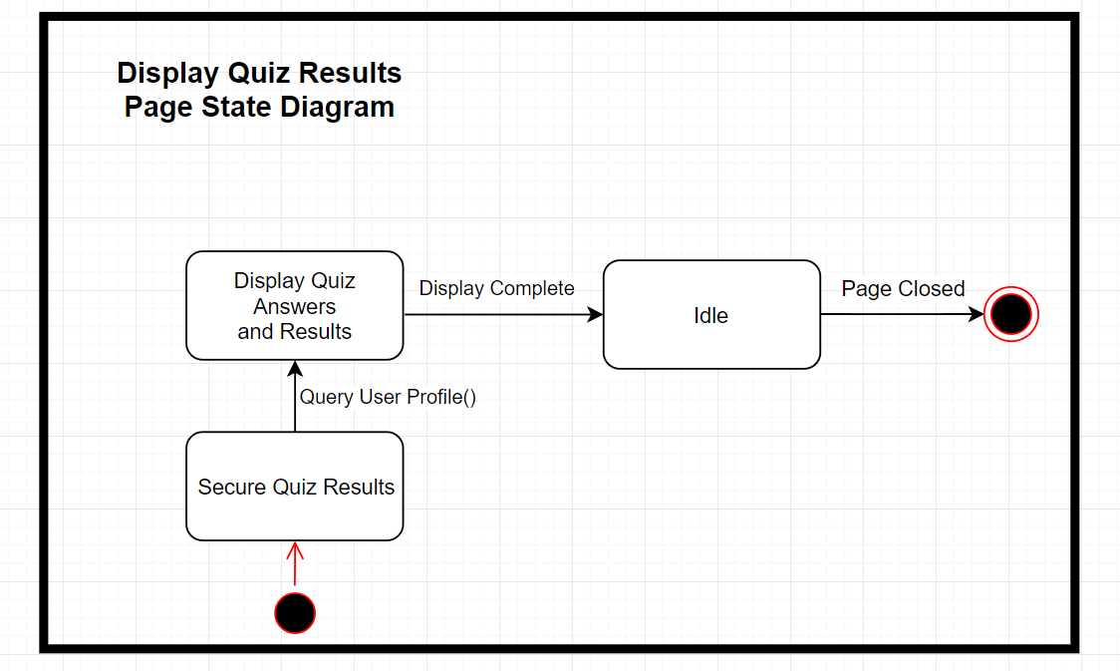
View Results Page

Slide 10
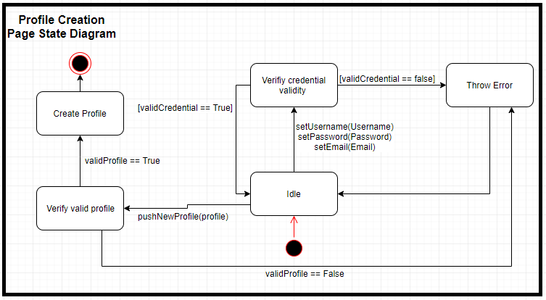
Profile Creation Page

Slide 11
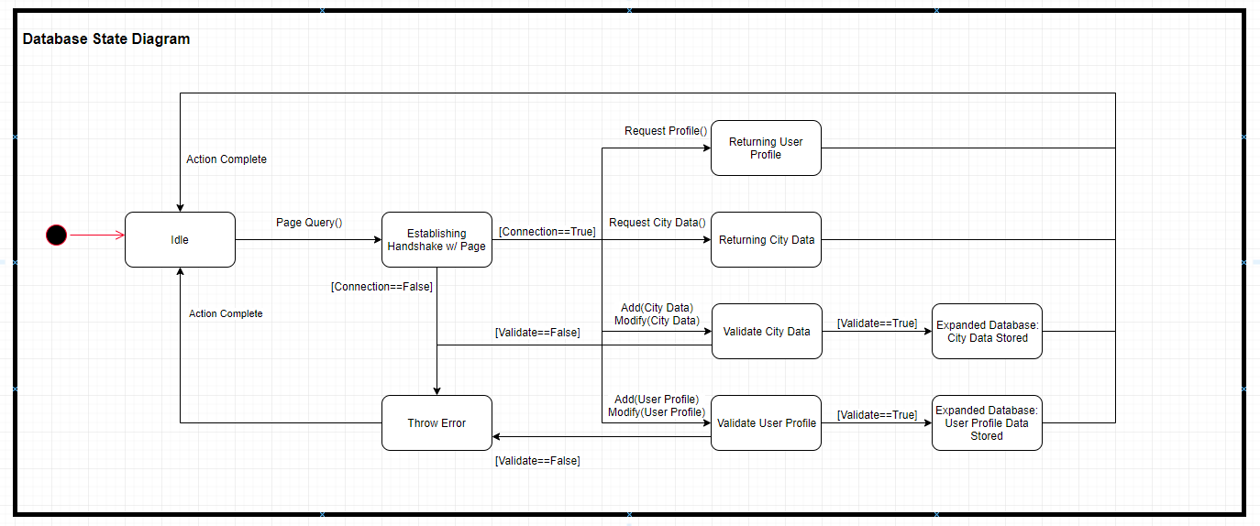
Database

Slide 12
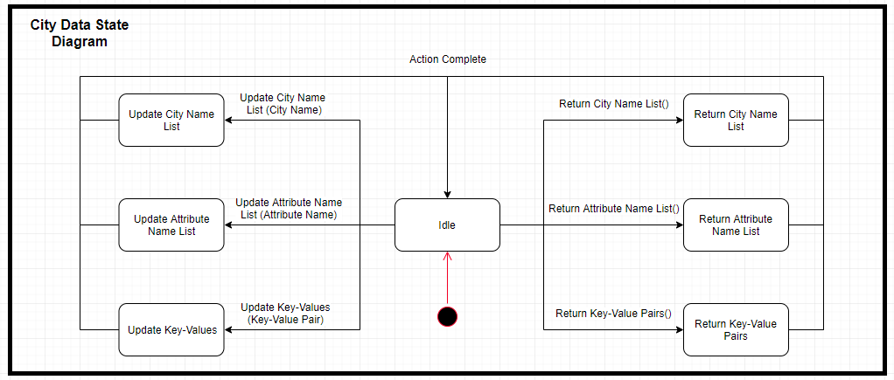
City Data

Slide 13
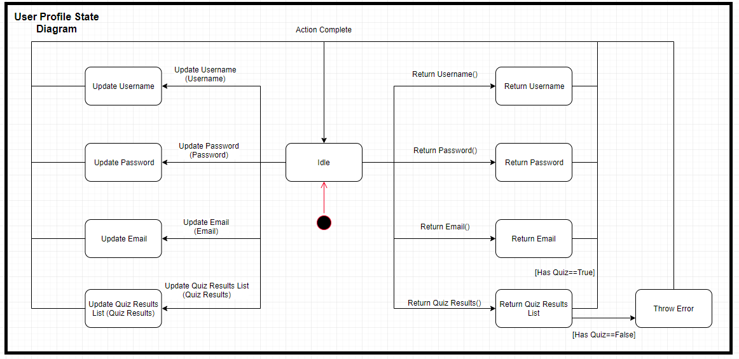
User Profile

Slide 14
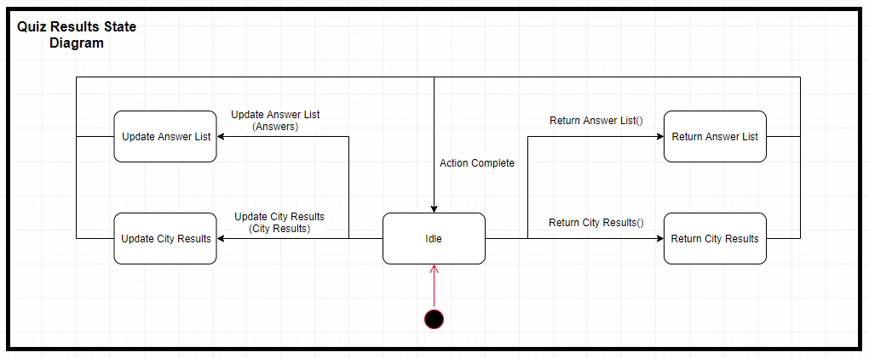
Quiz Results

